Slide 1
TAFE Talks
International opportunities for TAFEs
Andrew Williamson
Holmesglen Institute
16 March 2022

Slide 2
International Onshore
New Student Enrolments
Slow trickle, but a trickle with promise
Global demand
Source markets
Agent networks
Competition
Offshore pathways programs
New delivery models
Currently Onshore / Enrolled
The lure of F/T work
Flipping current students
Alumni
Post-study work visa holders

Slide 3
International Offshore
Opportunities
New delivery models
New products (non-AQF, degrees)
New markets
Making existing partnerships work harder
Industry partnerships
Skills-based recoveries (diplomacy and positioning)
Threats
COVID: the saga continues
Shattered economies
Global unrest
Competition

Slide 4
Other
ELICOS
Offshore
Onshore
Packaging
Internationalisation
Doubling down
Student / staff mobility
Unbundling / rebundling
Teacher Training
TESOL
IST
HE Skills
Partnerships
Between TAFEs
With industry
G2G

Slide 5
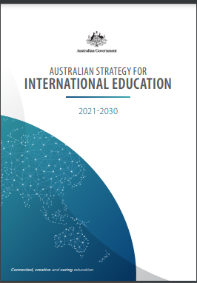
Australian Strategy for International Education 2021 - 2030
Priorities
Diversification
Meeting Australia’s skills needs
IST
Research & innovation collaboration
Students at the centre
Connection to Australian students & communities
International education mobility
Growth and global competitiveness
Review of ESOS
Visa settings
Notes:
Canada could stop having such welcoming policies
Australian Government – could start having welcoming policies/language
Role that migration has in our communities, economy
International Education Strategy formulation underway, Min Tudge flagged incentives towards international students studying courses in Australian skills shortage fields….
Mickleham – costs to providers – how to stop just Go8 access

Slide 6
Thank you!
Andrew Williamson
Executive Director – International Education & Enterprise Solutions
Holmesglen Institute
andrew.williamson@holmesglen.edu.au

