Slide 1
National Skills Commission

Slide 2
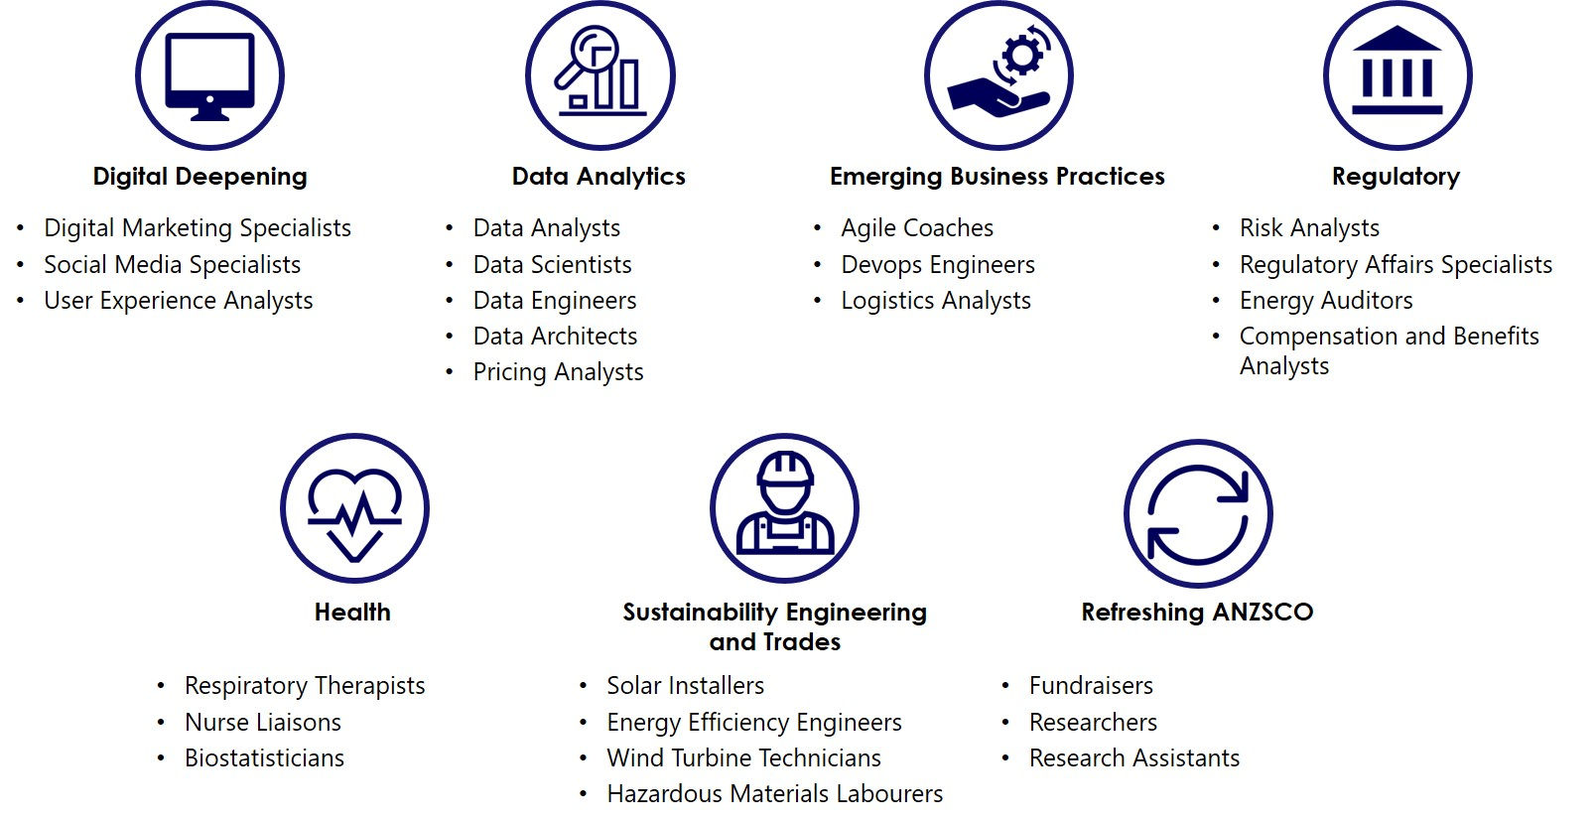
Emerging Occupations
Skill requirements evolve in most jobs; however, sometimes the demand for new skills changes the nature of a role enough that a new occupation emerges.
Web developers have for some time been expected to have coding skills, but recent demand for web developers with Agile methodology and software engineering skills has lead to the emergence of new roles like user experience analyst and DevOps engineer.
In 2019, the NSC developed a data-driven approach to identify emerging occupations and published a report on 25 new, frequently advertised jobs which were not well defined in the Australian and New Zealand Standard Classification of Occupations (ANZSCO).
The NSC is currently working with the ABS on its new, targeted approach to updating ANZSCO which will see several of the Emerging Occupations incorporated, either as new occupations or as specialisations of existing occupations.

Slide 3
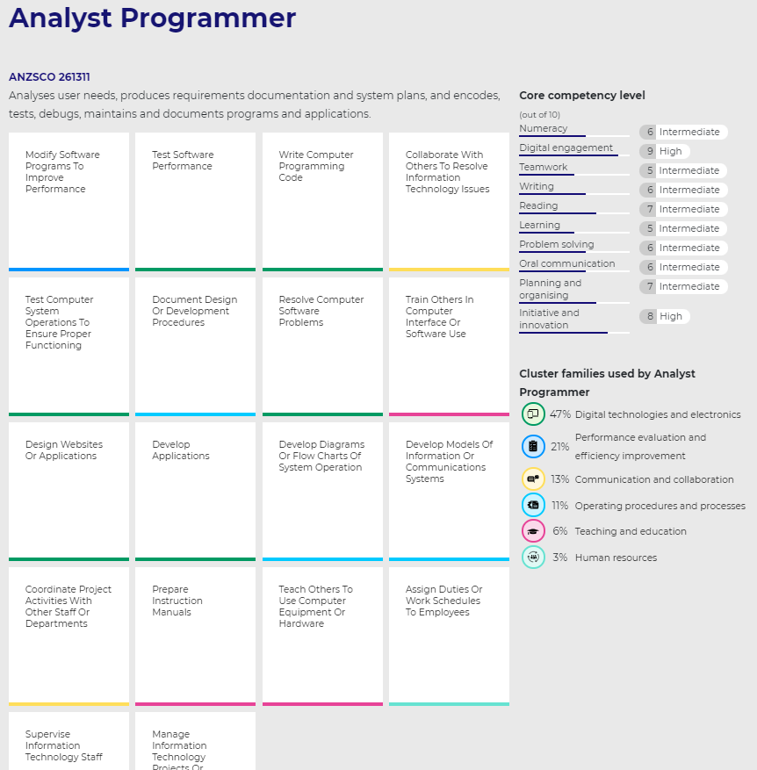
The NSC has released the Australian Skills Classification
The Australian Skills Classification (ASC) is the backbone of JEDI.
Provides the basis for turning an occupation based view of the economy into a skills based view – by mapping the way occupations are made up of skills.
610 skills profiles of occupations with three elements
10 core competencies common to all jobs
88 technology tools (software and hardware)
1943 specialist tasks, specific to jobs, clustered up into 280 skills clusters which in turn group into 29 skills cluster families.
Defining the labour market through a skills lens offers a richer understanding of what underpins an occupation and explains in a practical way how skills learnt in one occupation can be found in another.
The same principle can then be applied to VET qualifications – a skills lens can show how a skill learnt in one qualification can be found in other.
The ASC makes it possible to assess the skills at an economy wide level and project growth in demand for skills.
3

Slide 4
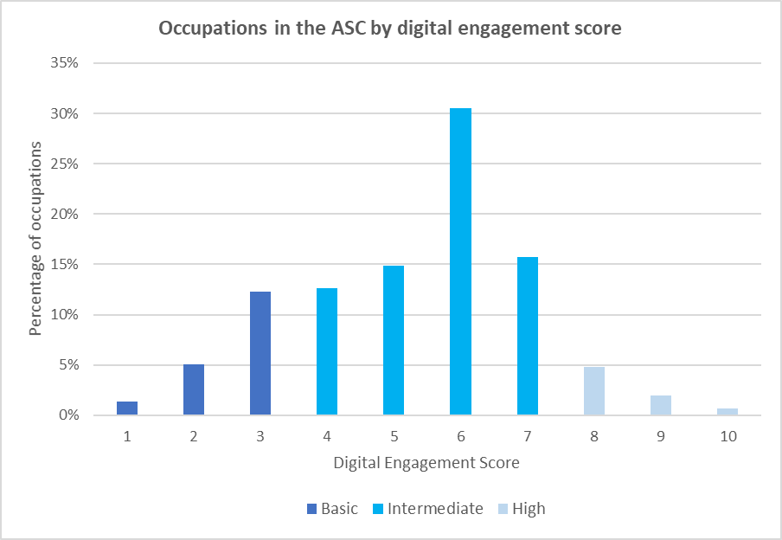
Digital engagement in the Australian Skills Classification
Digital skills in the ASC can be explored in three ways:
The technology tools related to an occupation.
Relevant specialist tasks (EG: from the digital technologies and electronics skills cluster family).
An occupation’s score against the ‘digital engagement’ core competency.
Each occupation is assigned a level of competency (1-10) for digital engagement. To help understand these values, each has an associated description. EG:
1 equates to being able to name familiar digital devices.
10 equates to being able to develop a new digital product to the complexity of blockchain.
Most occupations in the ASC require an ‘intermediate’ level of digital engagement (4-7).
Most are level 6, which equates to being able to use software on a portable device to record information and upload files or photos.
The descriptions for core competencies are general.
4

Slide 5
Projected growth in demand for skills by skills cluster family - five years to Nov 2025
Hours per week spent on skills cluster family in 2020 (‘000)
01 | Performance evaluation and efficiency improvement | 16 | Vehicle operation
02 | Digital technologies and electronics | 17 | Science and mathematics
03 | Food services | 18 | Art and entertainment
04 | Health and care | 19 | Fashion, grooming and cosmetics
05 | Security and emergency services | 20 | Cleaning and maintenance
06 | Teaching and education | 21 | Customer service
07 | Communication and collaboration | 22 | Construction
08 | Business operations and financial activities | 23 | Work activities preparation
09 | Human resources | 24 | Quality control and inspections
10 | Records, documentation, reports and research | 25 | Sales and marketing
11 | Operating procedures and processes | 26 | Production processes and machinery
12 | Safety and hazard management | 27 | Material transportation
13 | Data, analytics and databases | 28 | Agriculture and animals
14 | Environmental management | 29 | Archiving, recording and translating
15 | Recreation and sporting events
5
Source: Australian Skills Classification and NSC analysis of Employment Projections

Slide 6
Projected growth in demand for skills in Digital Technologies and Electronics - five years to Nov 2025
Within the Digital technologies and electronics cluster family, we see varying growth rates.
Growth is stronger for skills clusters involving software development, design and performance
Skill clusters involving the maintenance of the physical electronic and digital components are projected to grow, but less strongly than the rest of the cluster family
6
Source: Australian Skills Classification and NSC analysis of Employment Projections

Slide 7
Projected growth in demand for skills in Data, analytics and databases - five years to Nov 2025
Within the Data, analytics and databases cluster family, we also see differing growth rates.
The use of data to inform decisions is expected to grow, with the greatest growth expected in using data to inform operational decisions and operations research and management
Collecting samples and analysing results is projected to experience a slight decline
7
Source: Australian Skills Classification and NSC analysis of Employment Projections

