Slide 1
About Tasmania
Small jurisdiction – population of around 540,000
Single TAFE
State-wide reach with 16 campuses and training facilities.
Training across priority industries for Tasmania such as health, aged care and community services, construction, engineering and electrotechnology.
TasTAFE has a role in assisting “last-chance learners” and addressing socio economic challenges including low literacy, intergenerational poverty and high levels of disability.

Slide 2
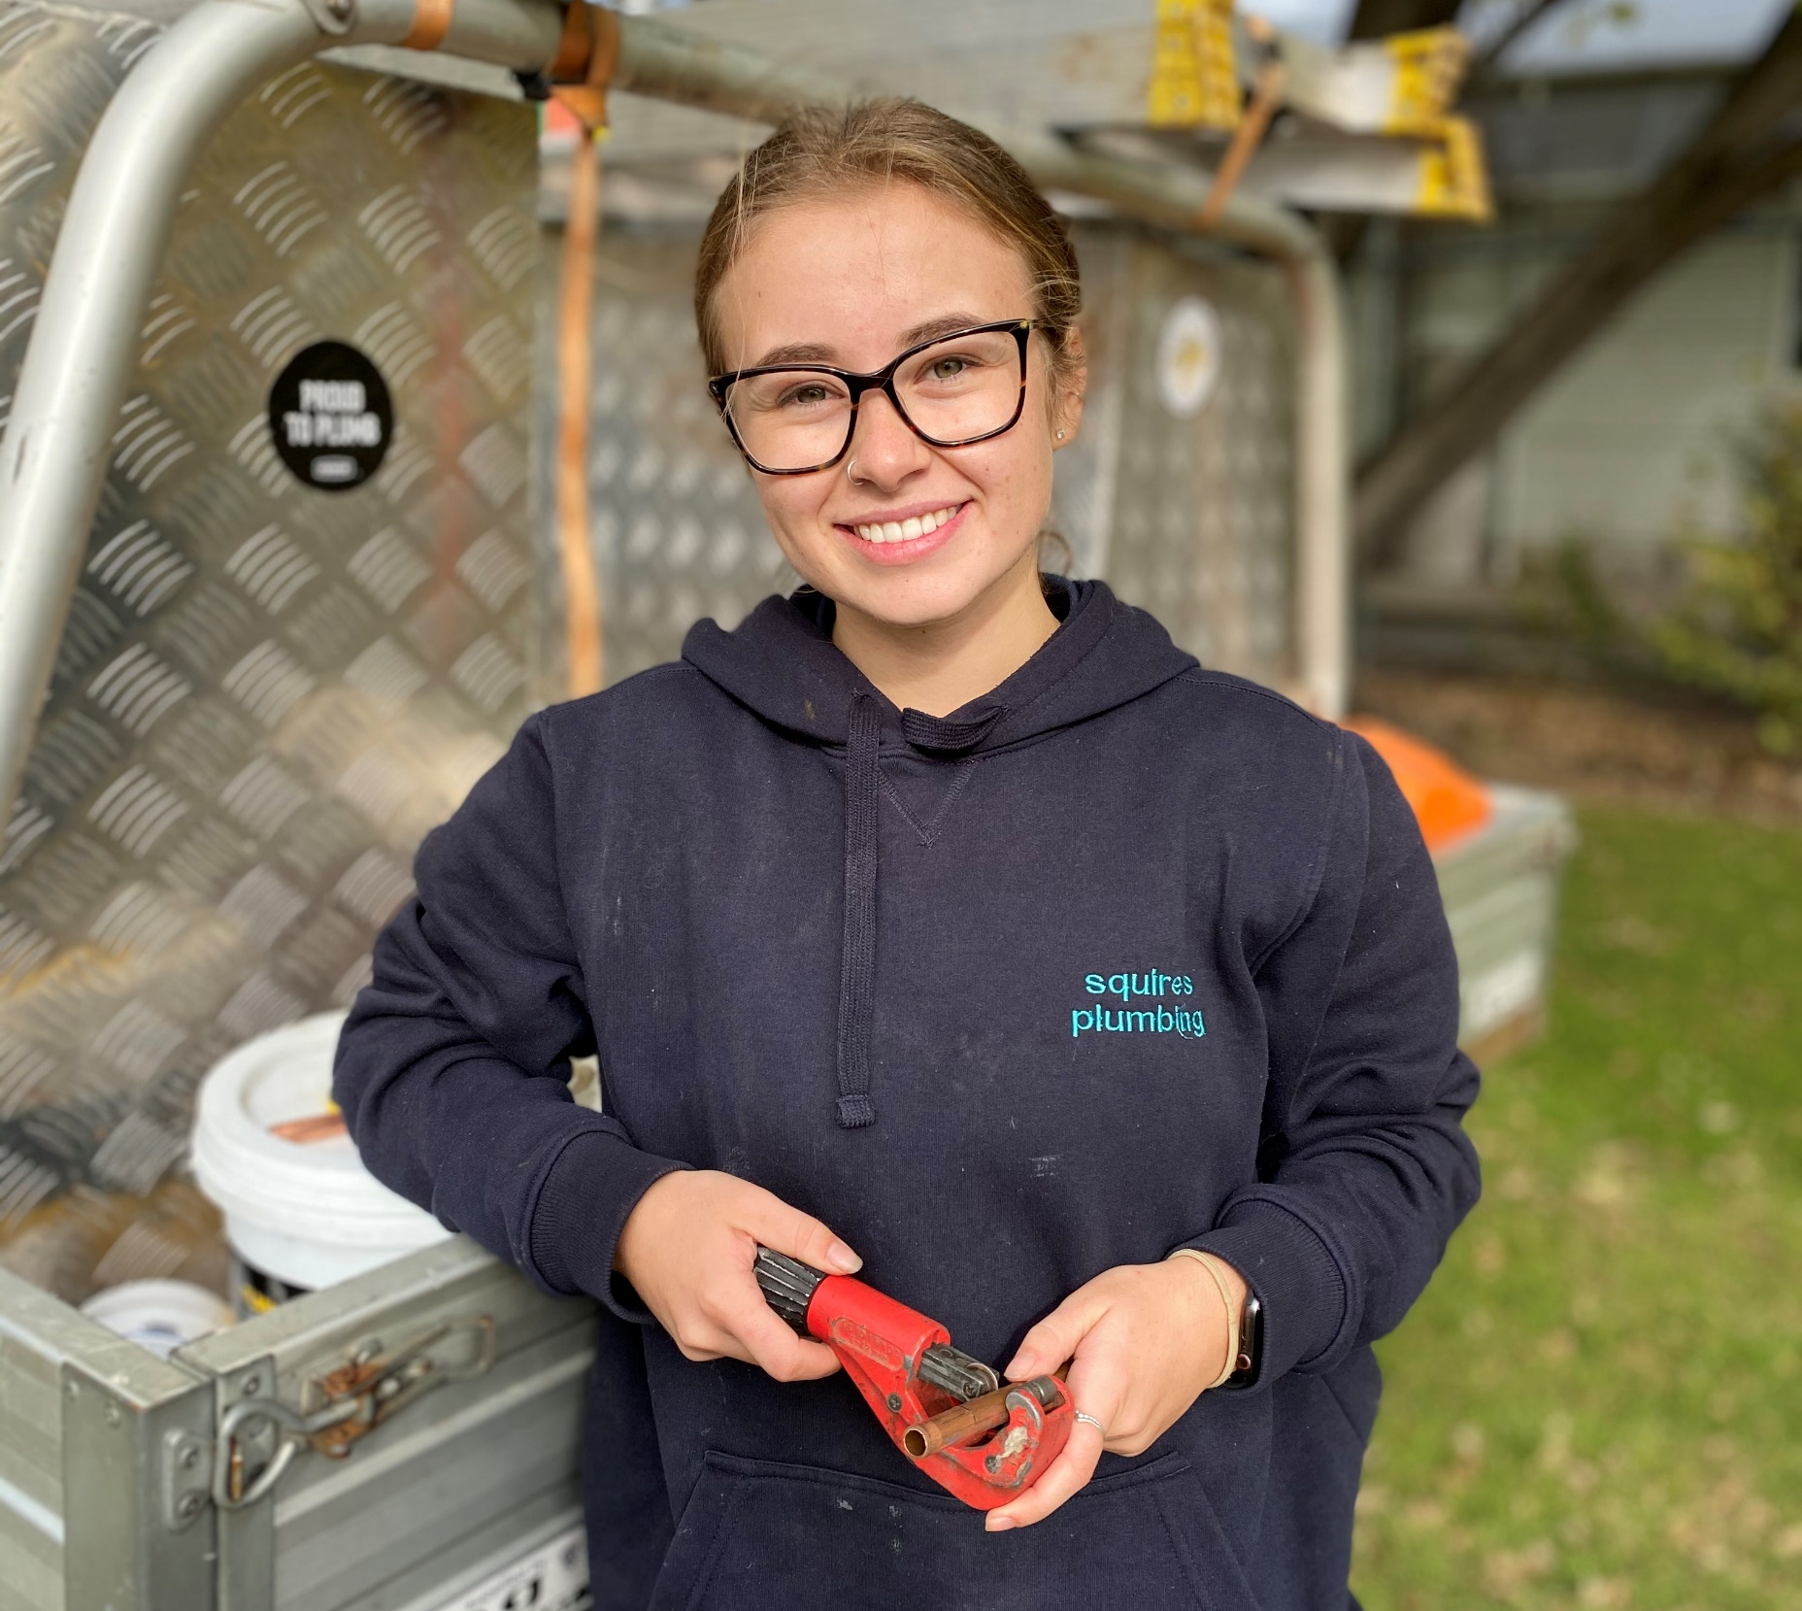
TasTAFE apprentices
TasTAFE trains around 60% of Tasmania’s apprentices.
Apprentice numbers have increased by around 20 per cent in the last 2 years.
Demand continues to grow in traditional trades
High-demand areas include:
Building and Construction
Energy Industries
Automotive
Engineering and Manufacturing

Slide 3
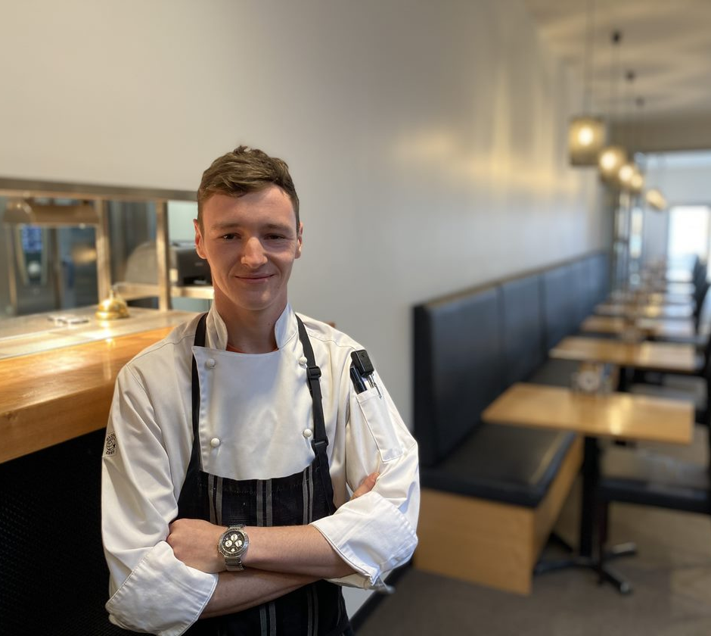
Tasmania’s apprentice completion rates
Highest completion rates in Australia*
Tasmania: 55.9%
National average: 48.3%
TasTAFE trains all apprentices in some trades.
(*Source: NCVER contract completion figures released July 2021)

Slide 4
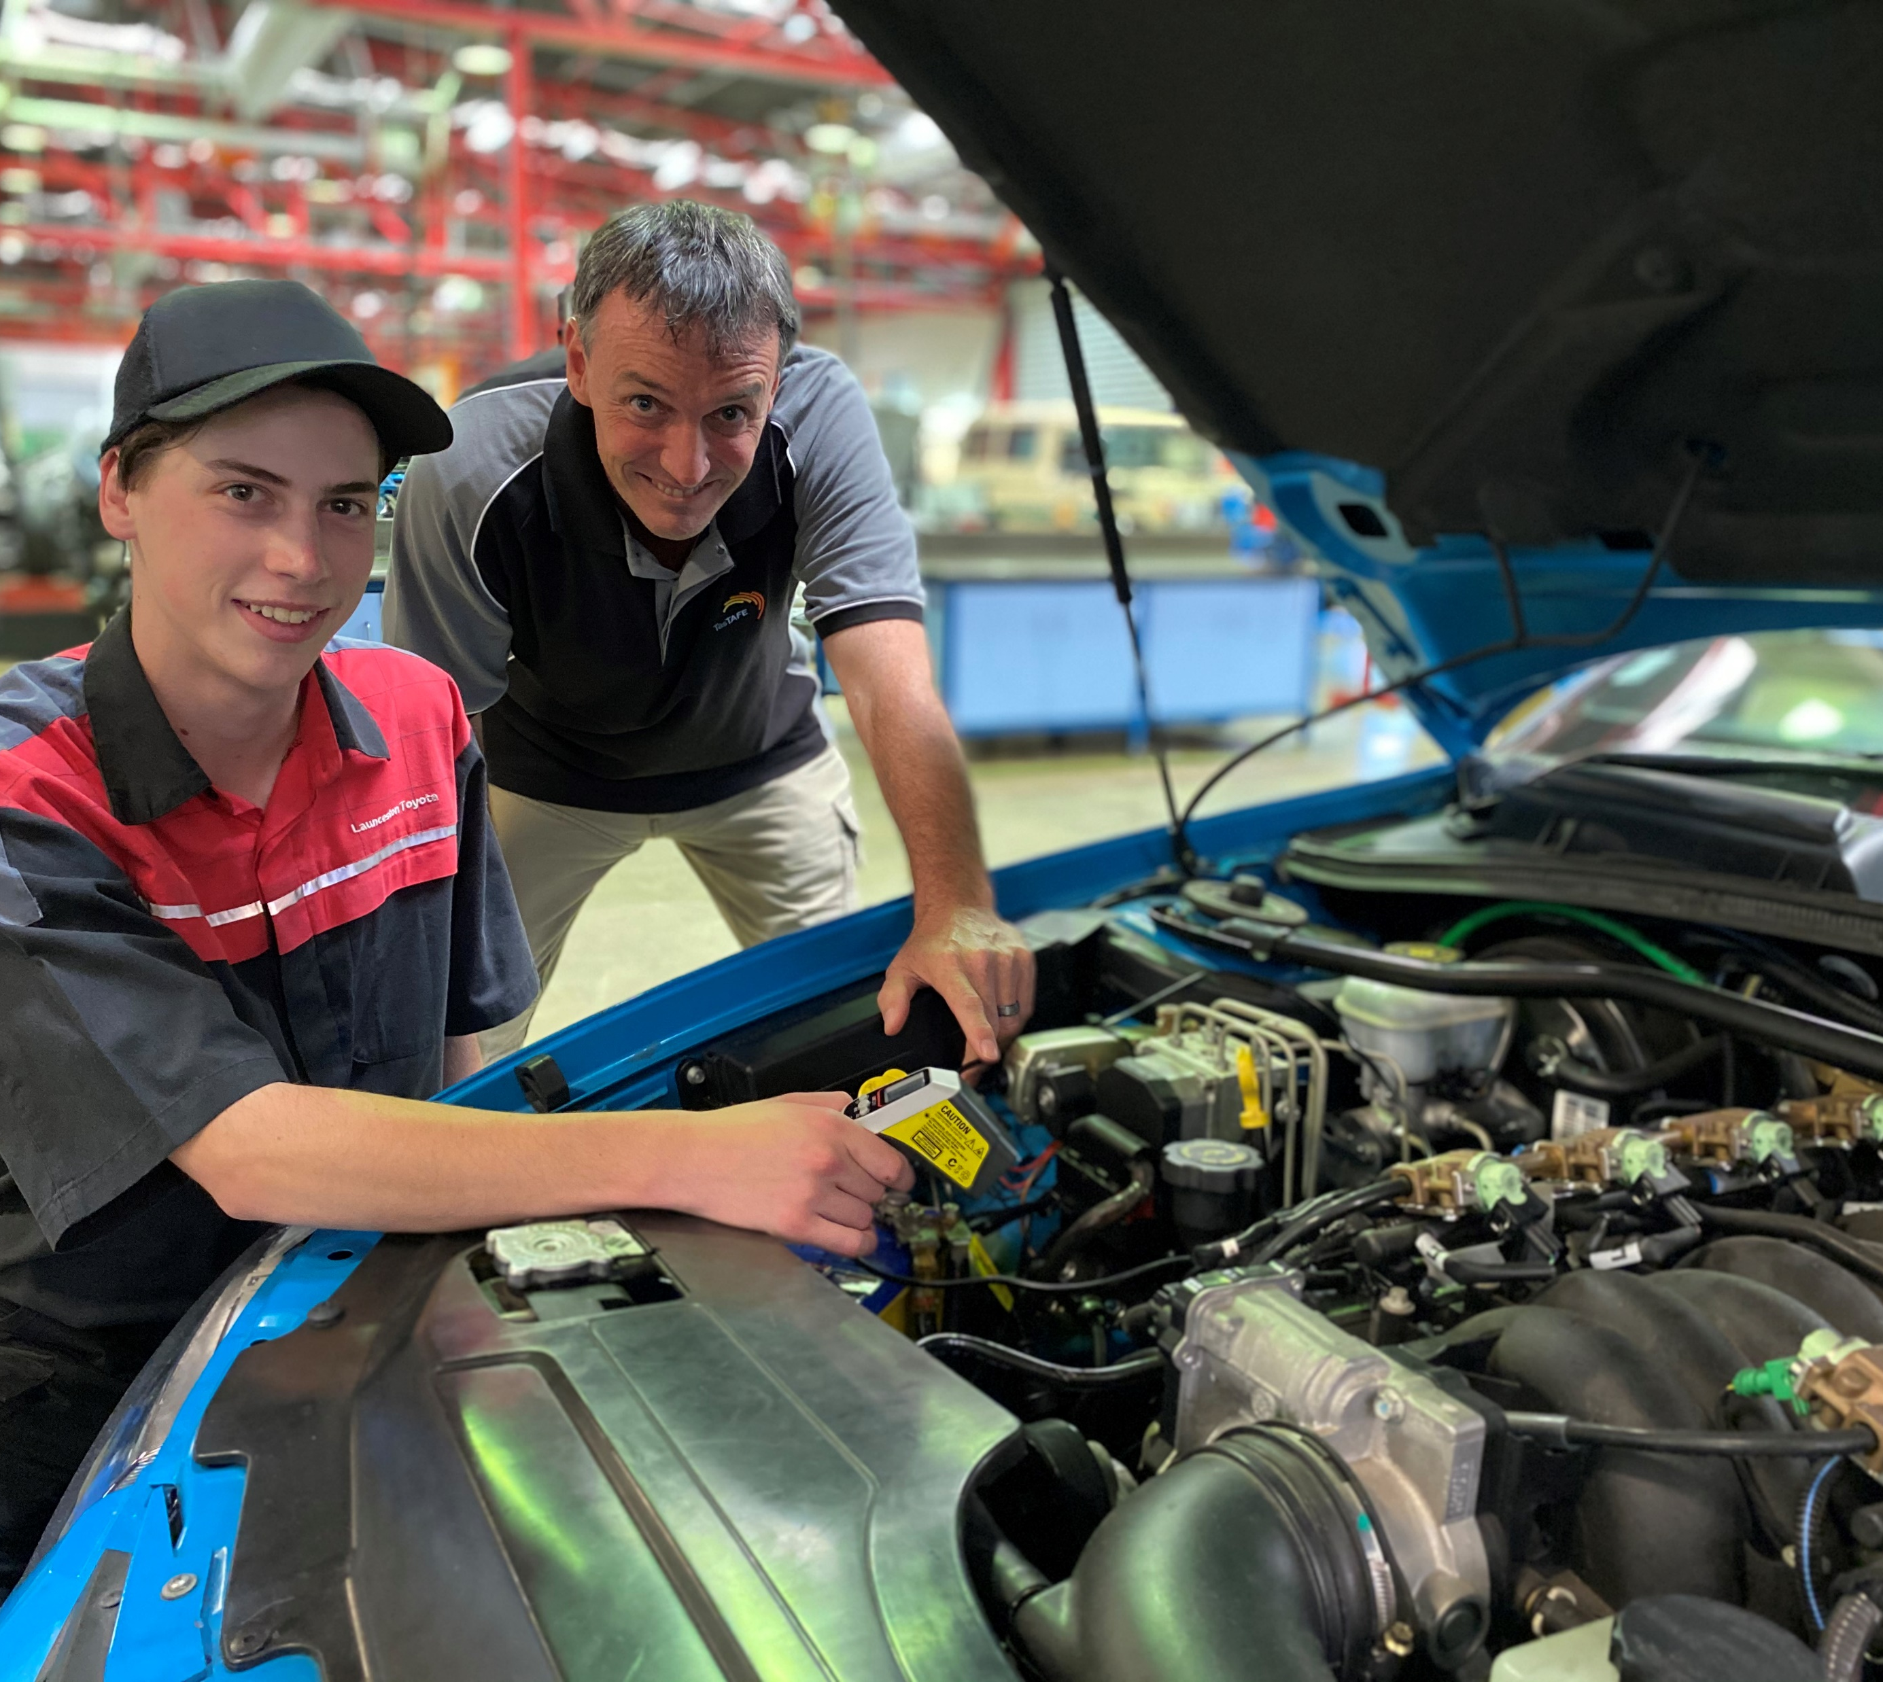
Why our completion rates are good
Small state
Regional spread
Close contact with industry and other key players in the apprenticeship system
Communication with employers and apprentices
Portfolio managers
Support beyond learning eg support for those with low literacy and numeracy

Slide 5
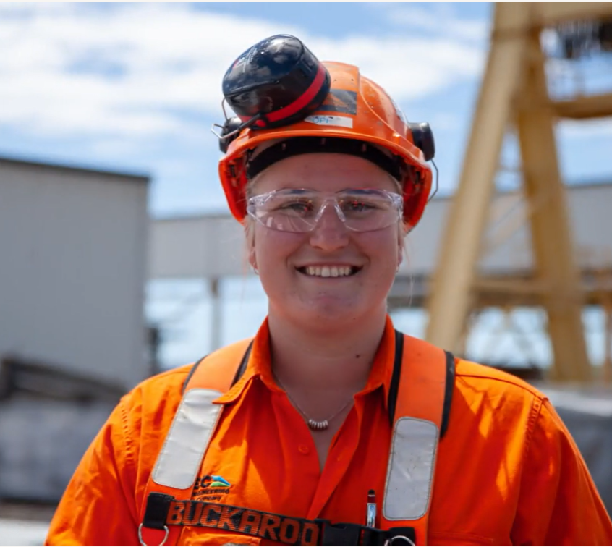
Supporting our apprentices
Sophie Russell, Apprentice of the Year
2021 Tasmanian Training Awards:
“The support I received from TasTAFE was amazing.
“My TAFE teacher, Shane, would come out on-site, touch base to see how we were travelling, what modules at TAFE we were struggling with, talk about when our next TAFE session was and would just always be there.”

Slide 6
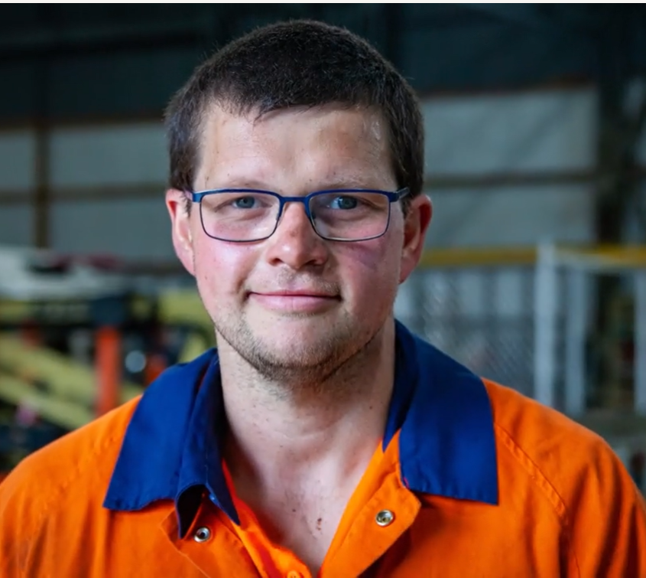
Student support
Michael Taylor, Equity Apprentice of the Year
2021 Tasmanian Training Awards:
“I have a visual impairment and obviously it was a bit daunting heading into the course initially, but the disability liaison staff at TasTAFE were really encouraging and made me feel like there were no barriers and I was able to successfully complete the course.”

Slide 7
Improving completion rates
Apprenticeship orientations
Learning Support Tutor roles
Supporting female apprentices
Support outside learning:
Disability support
Literacy and Numeracy

Slide 8
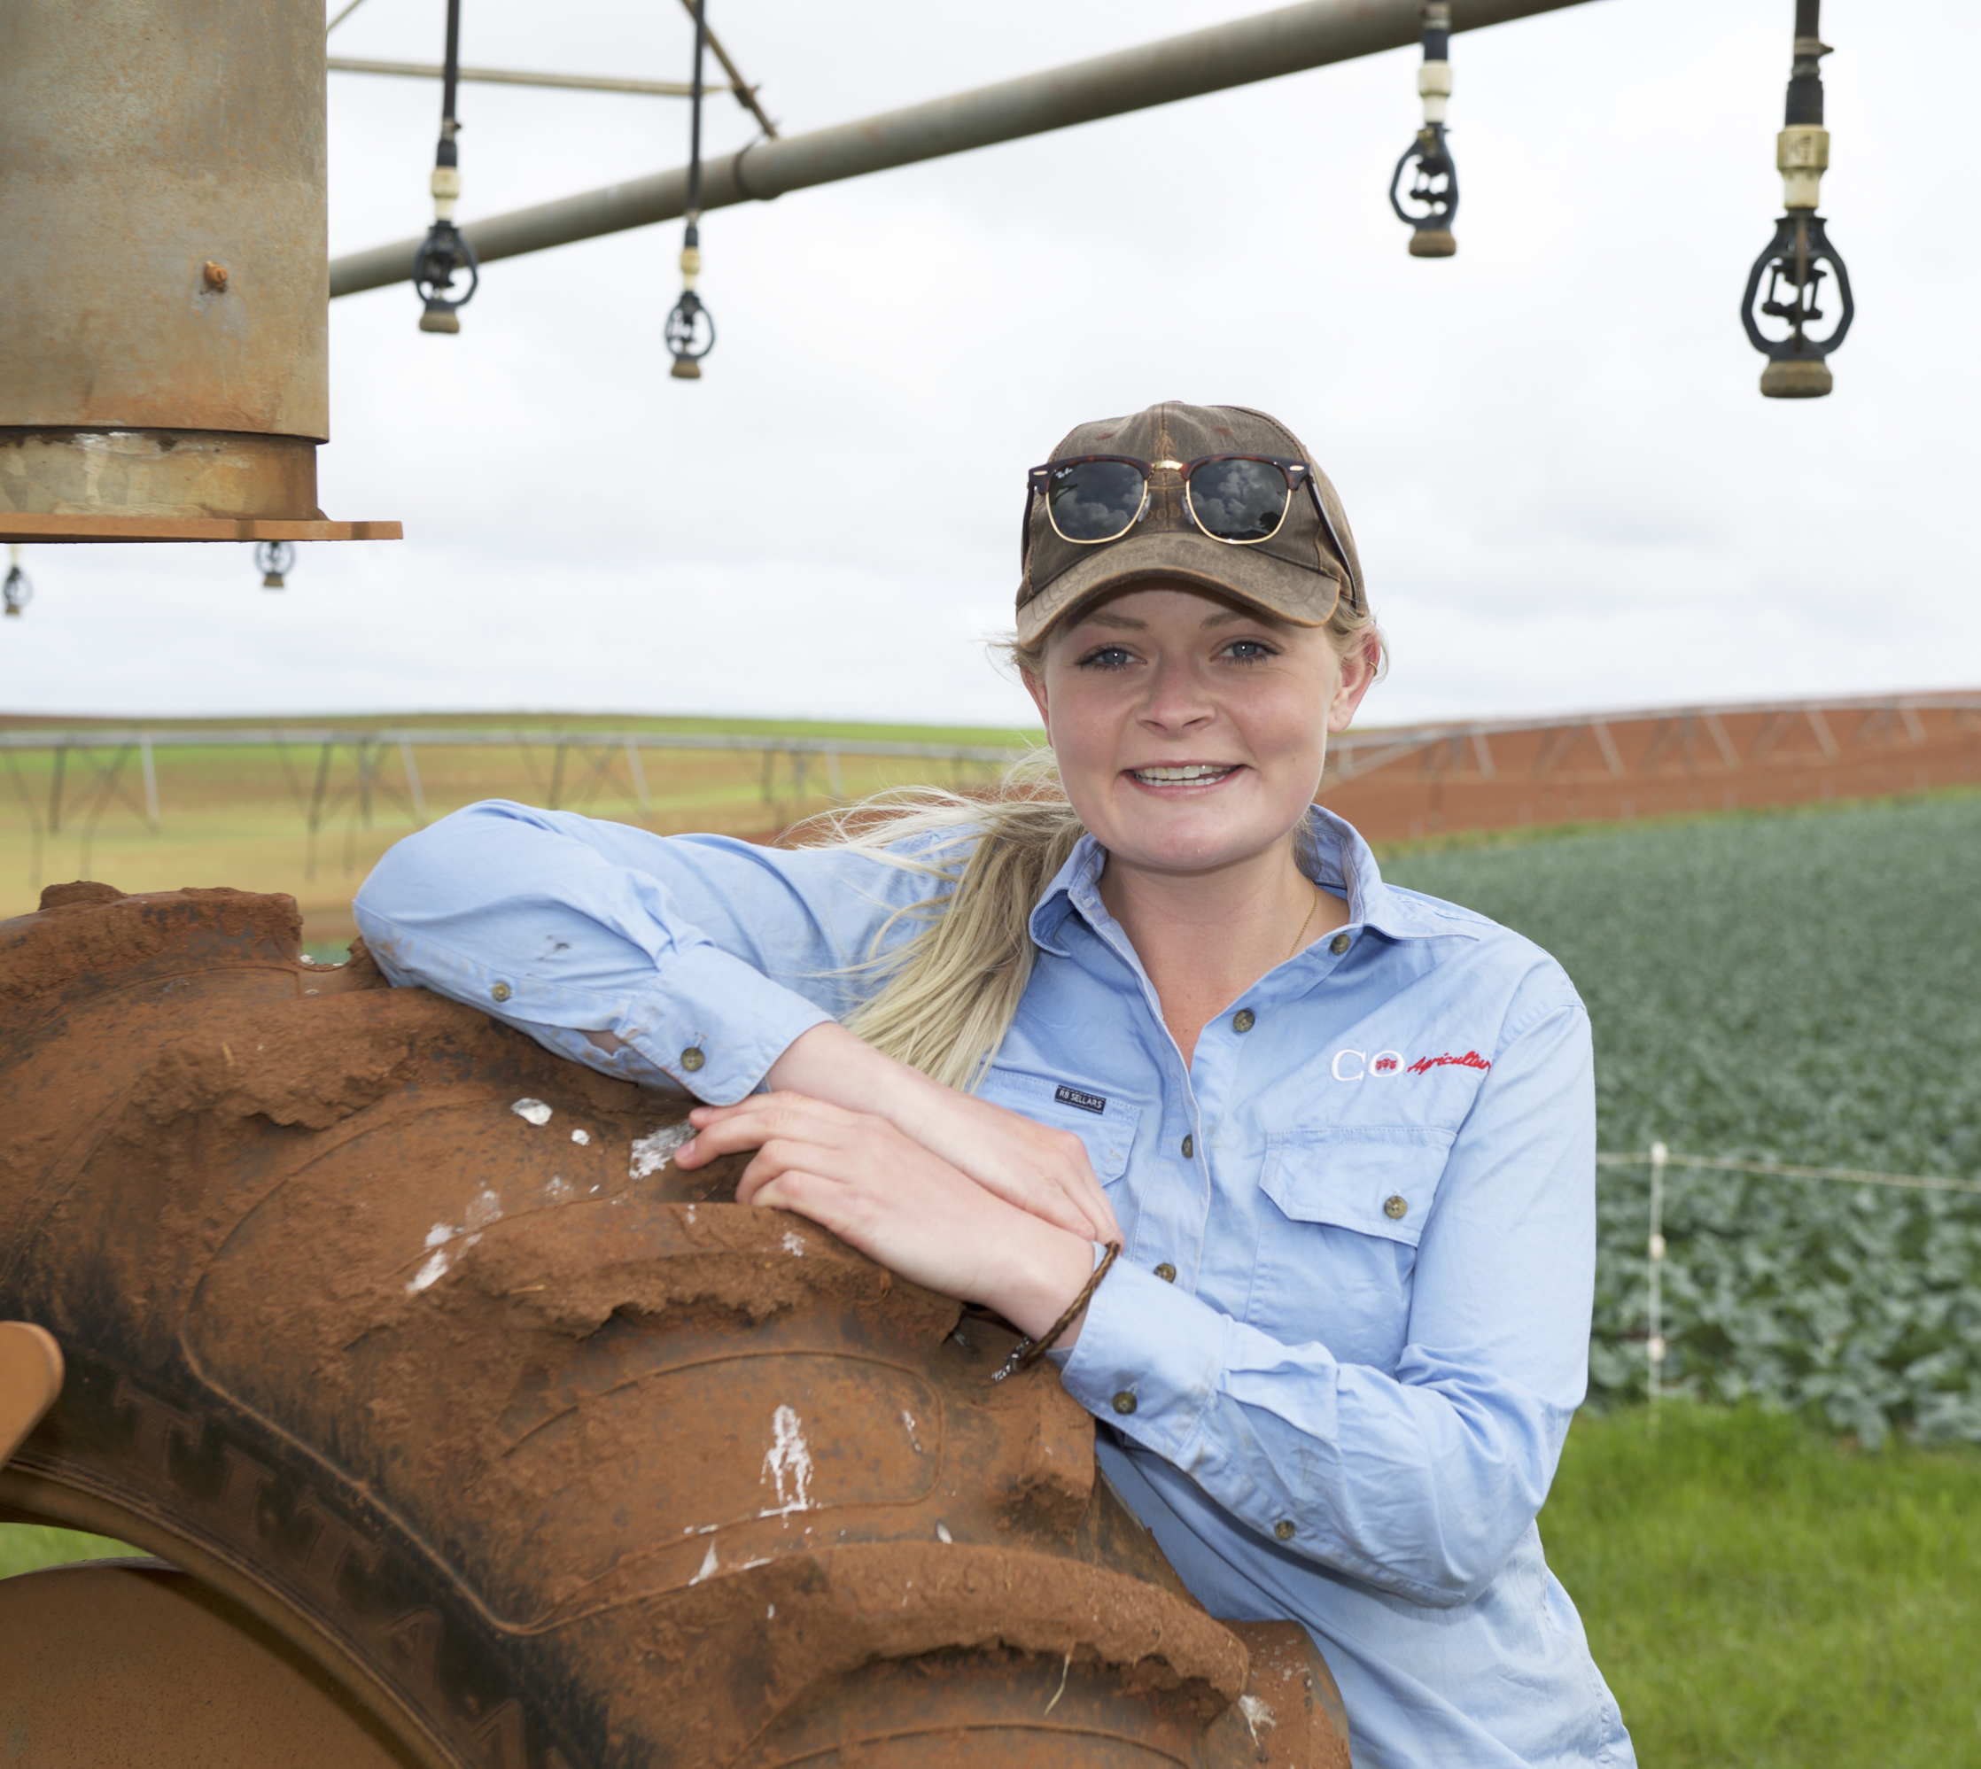
Supporting Female Apprentices
Caitlin Radford – 2020 Australian Apprentice of the Year (Australian Training Awards)
“Studying at TasTAFE has allowed me to gain many skills so that I can now fulfill my career ambitions.”

Slide 9
Questions

